Slide 1
Third Party Encrypted Storage
Travis Taylor, John Robe, and Daniel James

Slide 2
Problem
Remembering passwords is hard
Putting trust in another party is also less than desirable

Slide 3
Solution
Put our data encrypted in one place
Generate our key from another location
Decrypt the data in the database
Immediately forget the key
Four parties:
User
Database Server
Portal Server
User application

Slide 4
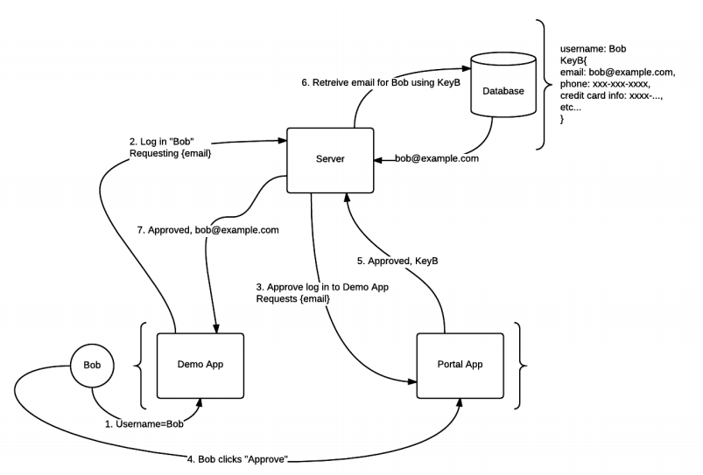
Design

Slide 5
Solution – Example Scenario
User Bob wishes to send his credit card information to a site that uses our system
That site sends a request to the authentication server (with the requested data)
The third-party application opens up a connection to the portal site, the portal asks for the Bob’s permission
Bob accepts (or denies) the request, the key is generated via password input (or from a cache)
Key is sent to the server, the data is decrypted, sent to the third-party application, and then the key is forgotten
Notes:
https://www.websequencediagrams.com/
Application ->Bob: Wants information
Application->Authentication: Request data From server
Application->Portal: Opens connection for Bob
Portal->Bob: Asks permission
Bob->Portal: Grants permission
Portal->Authentication:Sends key
Authentication->Application: Sends decrypted data that was reqeusted

Slide 6
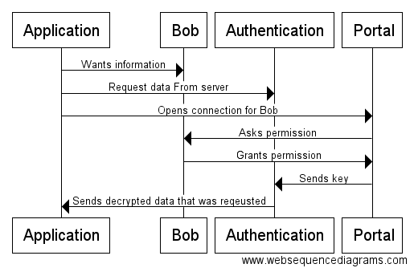
Solution – Message Diagram

Slide 7
Implementation Details
C++ Server
Apache Thrift for communication (RPC)
Java Demo App
Java Portal App
SSL everywhere

Slide 8
Conclusion - Benefits
The user never has to remember all of his information
Even if the authentication server is compromised, all of the data is encrypted, and the key doesn’t exist on that system.
The portal can generate and then forget the password itself.

